Slide 1
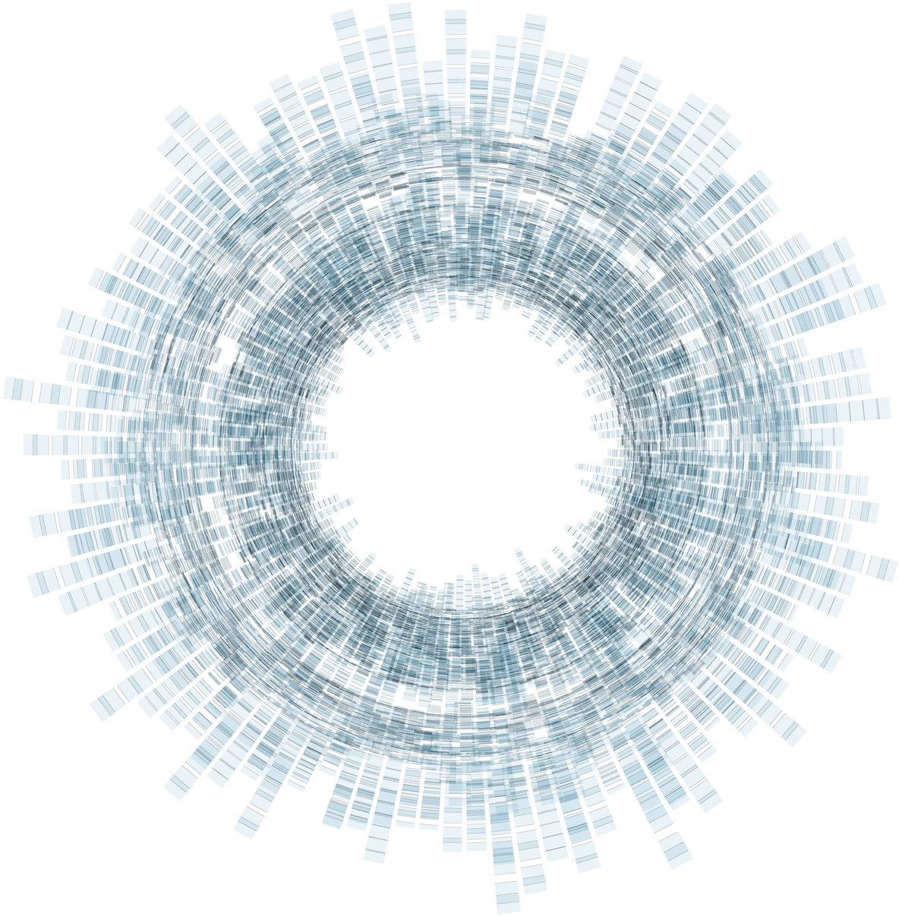

Artificiële Intelligentie
RCA AIG 04Q6 01 APRIL 2021
Computational Foundations of
Machine Learning [ML]
with Python
DataLab
Rob van der Willigen

Slide 2


CONTEXT
Prerequisites: basics in linear algebra, probability, and analysis of algorithms.
Workload: homework assignments
GitHub: Start a ML repository at GitHub

Slide 3
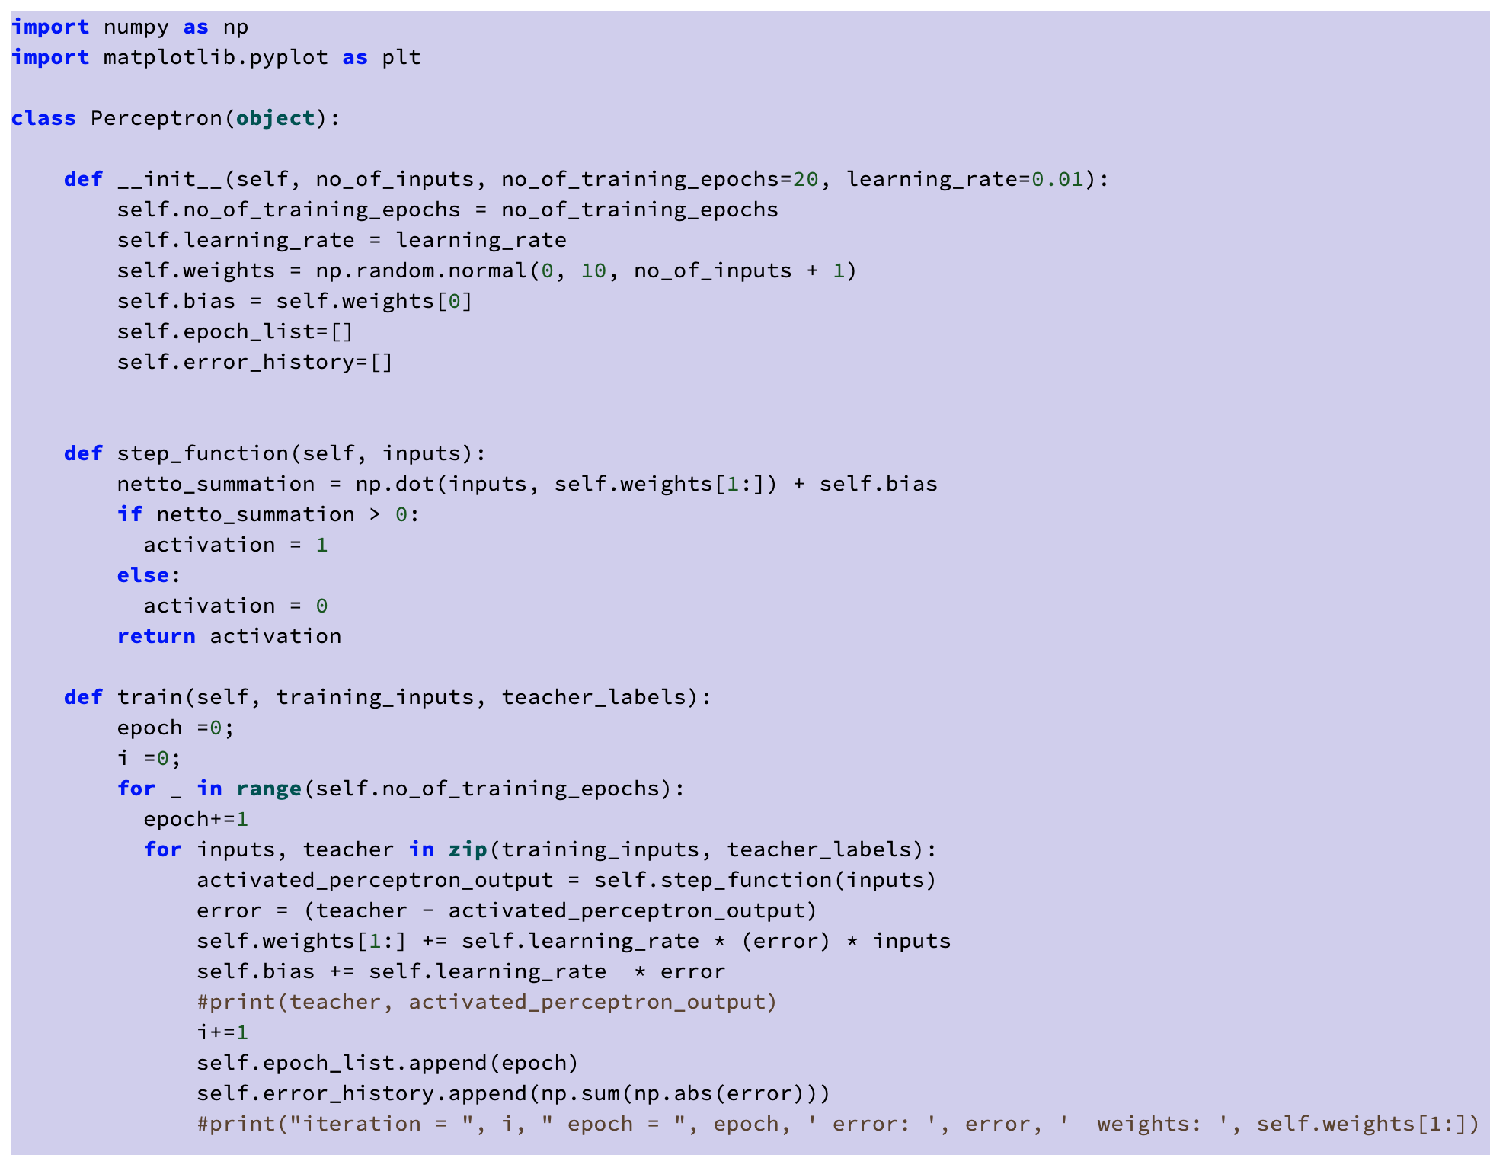
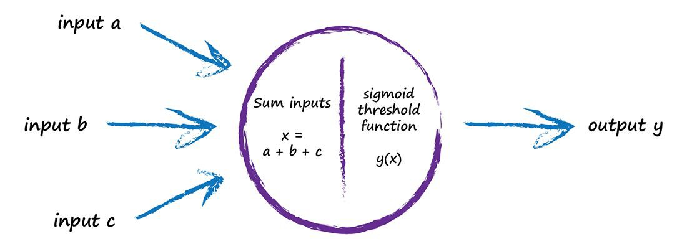
Lecture 03
Basic deﬁnitions and concepts of Machine Learning (ML) PART02. How to get from ML concepts & Models to Python code. THE DOT PRODUCT

Slide 4
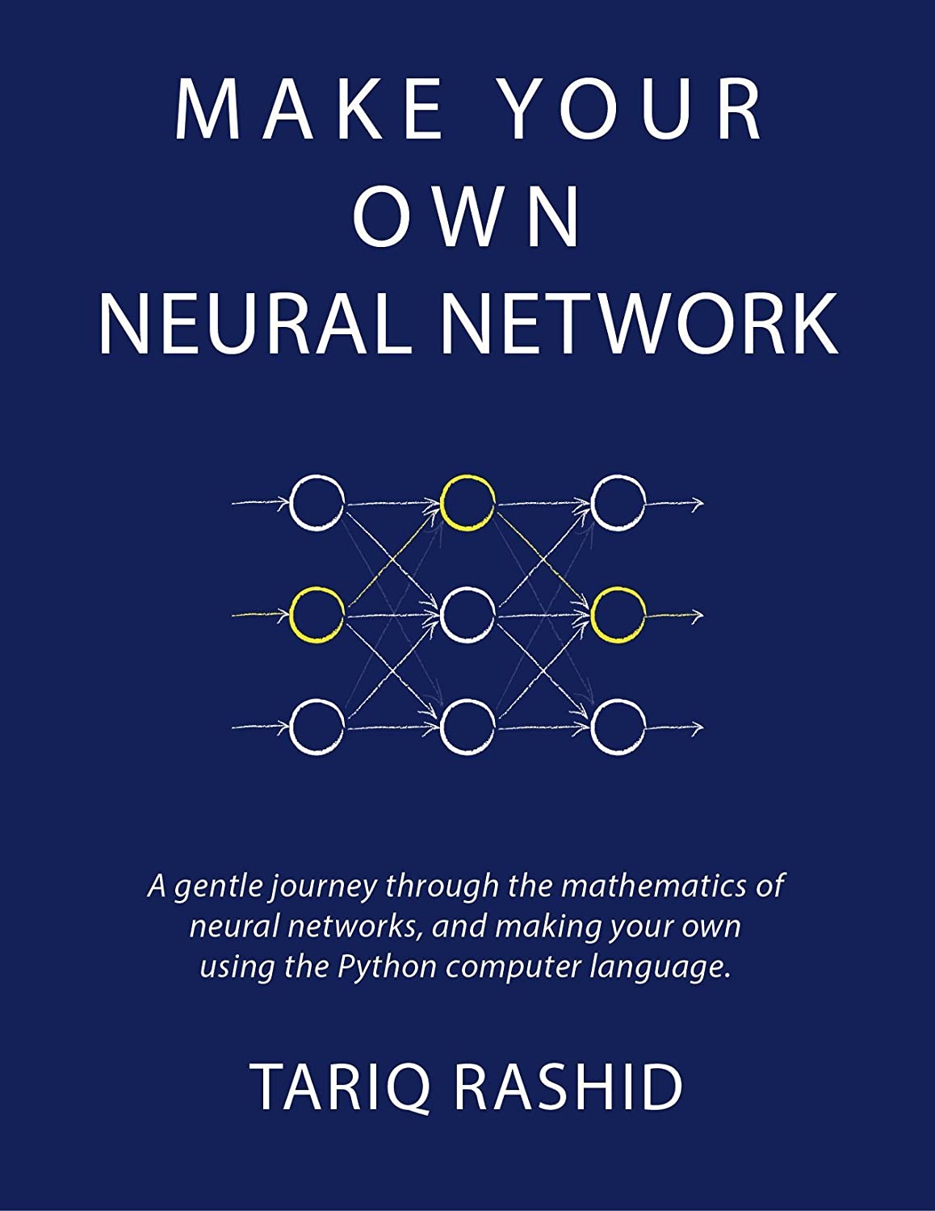
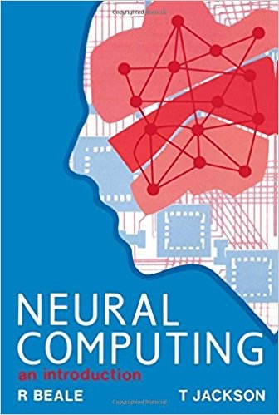
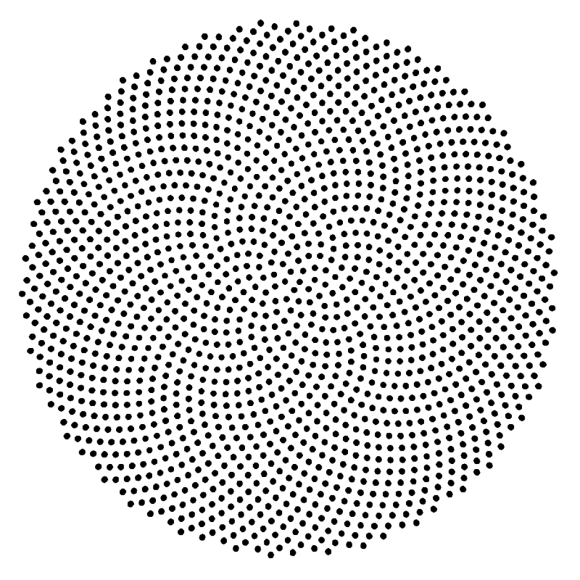
{01}
Fundamentals

Slide 5
{01}
Fundamentals
Key-words / Concepts / Labels
Artificial neuron === Model of single biological neuron / Perceptron
Feedforward / Feed-backward / Hebbian learning
Bias / Threshold
Weights /adjustable parameters / Memory
Unit / Node / Activation Functions (Sigmoid / Step)
Input / Output / Layers / Input vs Output Space
Target / Teacher / Error / learningrate
Iterations / Epochs / Baches
Logical functions AND / OR / XOR (Boolean Algebra)

Slide 6
{01}
Fundamentals
Maths + Python Key-words / Concepts
PYTHON MODULES import Numpy as np
import Matlibplot.pyplot as plt
class
def return
for (loops)
if else
zip
print
list
append
+=
Matrix Calculus
np.zeros
np.random.normal
np.dot
Plotting
plt.subplots()
plt.subplot(221)
plt.plot(epoch, error)
plt.xlabel('Epoch')
plt.ylabel('Error')

Slide 7
{01}
Fundamentals
The PERCEPTRON
The perceptron was very promising, but it was soon discovered that is has serious limitations as it only works for linearly-separable classes.
In 1969, Marvin Minsky and Seymour Papert
demonstrated that it could not learn even a simple logical function such as XOR.
This led to a significant decline in the interest in perceptron’s
and Machine learning as a whole.

Slide 8
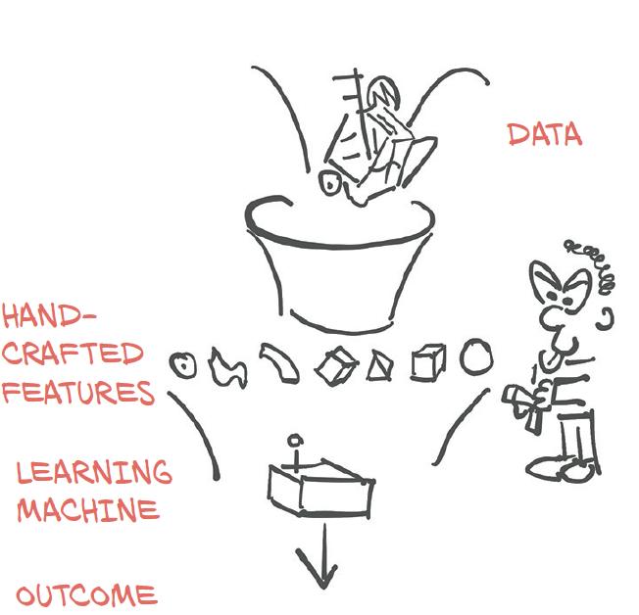
MACHINE LEARNING [ML]

Slide 9

{01}
Fundamentals
Simple Predicting Machine
The Concept of Machine Learning

Slide 10
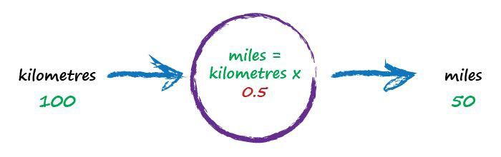
{01}
Fundamentals
Kilometres to Miles
The Concept of Machine Learning
random starting parameter
try a model - this one is linear

Slide 11
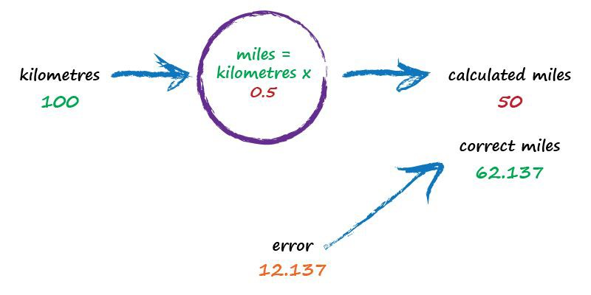
{01}
Fundamentals
Kilometres to Miles
The Concept of Machine Learning
not great

Slide 12
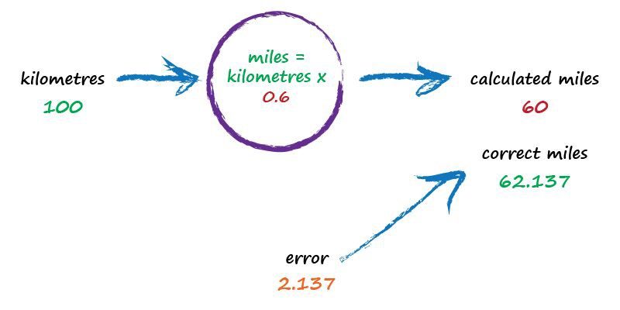
{01}
Fundamentals
Kilometres to Miles
The Concept of Machine Learning
better

Slide 13
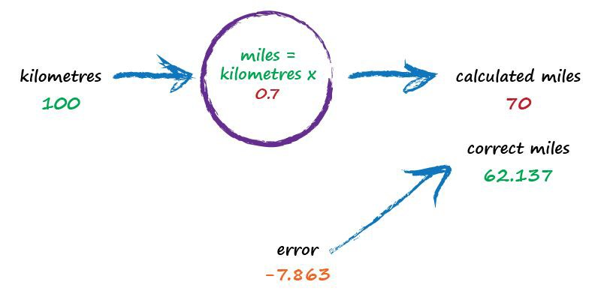
{01}
Fundamentals
Kilometres to Miles
The Concept of Machine Learning
worse !

Slide 14
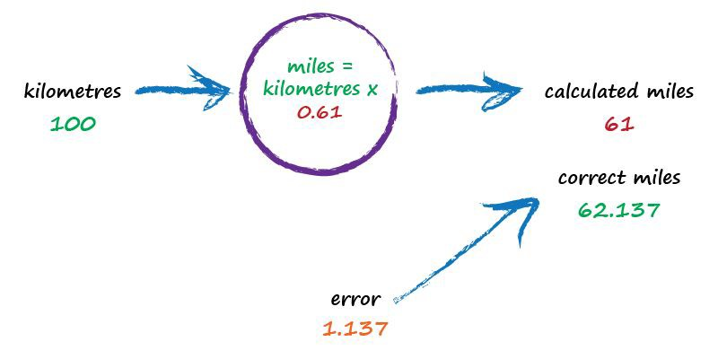
{01}
Fundamentals
Basic Concept of Machine Learning (ML)
is iterative in nature;
requires a teacher & memory
best yet !

Slide 15
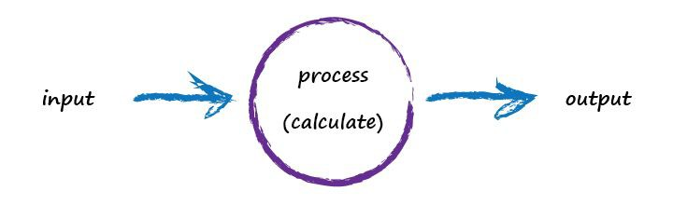
{01}
Fundamentals
Simple Predicting Machine
The Concept of Input / Output model

Slide 16
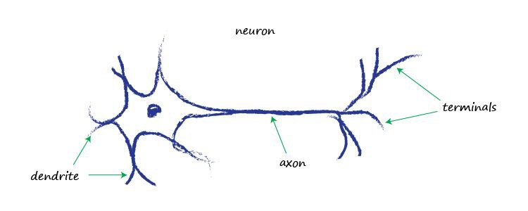
{01}
Fundamentals
Artificial Neuron
Artificial Neuron Model: input vs output

Slide 17
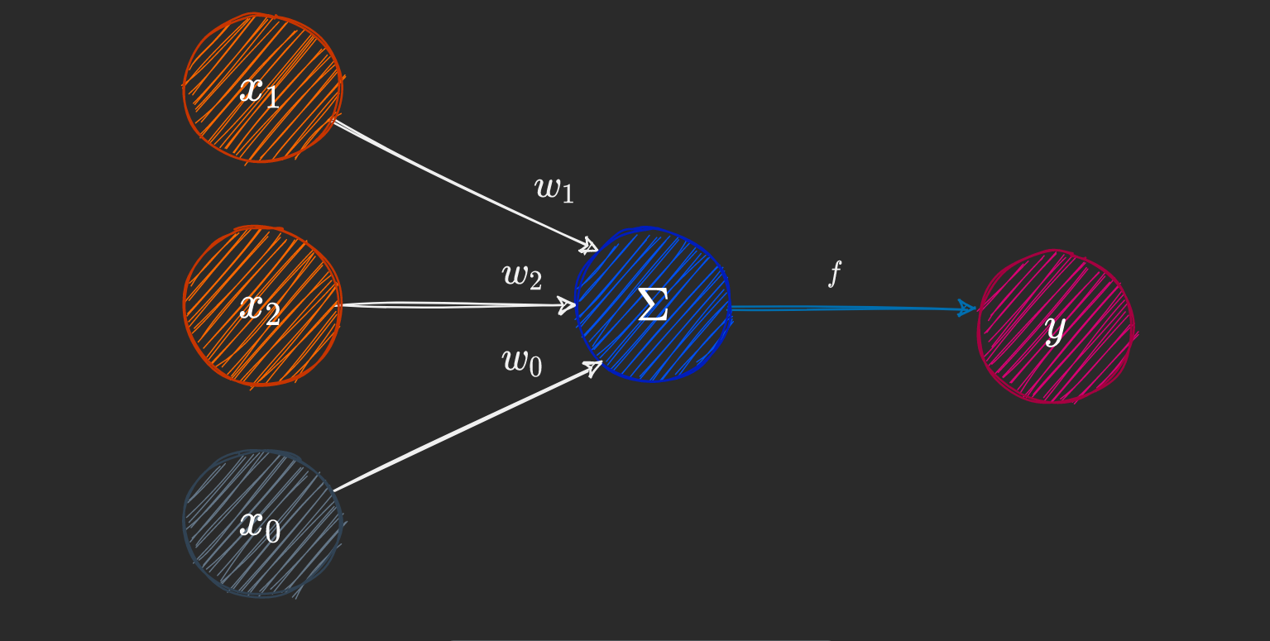
{01}
Fundamentals
Artificial Neuron
Artificial Neuron Model:
PERCEPTRON structure
Perceptron Components :
Input nodes x0 … Xn
Output node y
An activation function
Weights and biases
Summation
Activation Function f

Slide 18

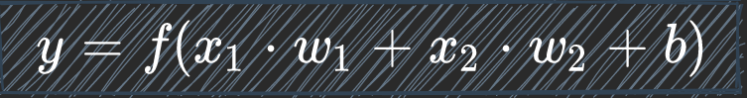
{01}
Fundamentals
Artificial Neuron
Artificial Neuron Model:
PERCEPTRON maths
FEED FORWARD CACULATION:
The output calculation is straightforward.
Compute the
DOT PRODUCT
of the input
[x1 x2]
and weight vector
[w1 w2]
The bias b equals w0
Apply the activation function.
Feedforward computation:
(DOT PRODUCT is a form of mathematical summation)

Slide 19
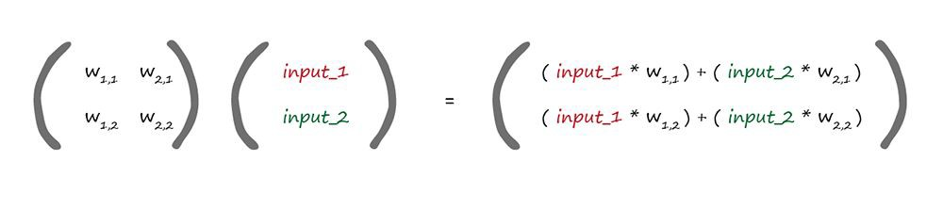
{01}
Fundamentals
Matrix Multiplication
Artificial Neuron Model:
PERCEPTRON maths
weights
incoming signals
W · I = X
dot product

Slide 20
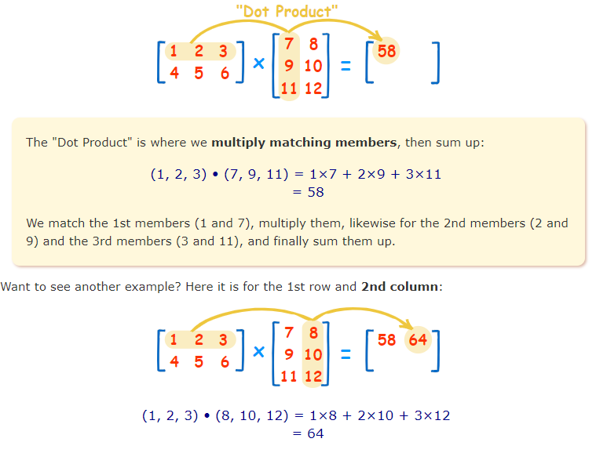
{01}
Fundamentals
XOR Puzzle!

Slide 21
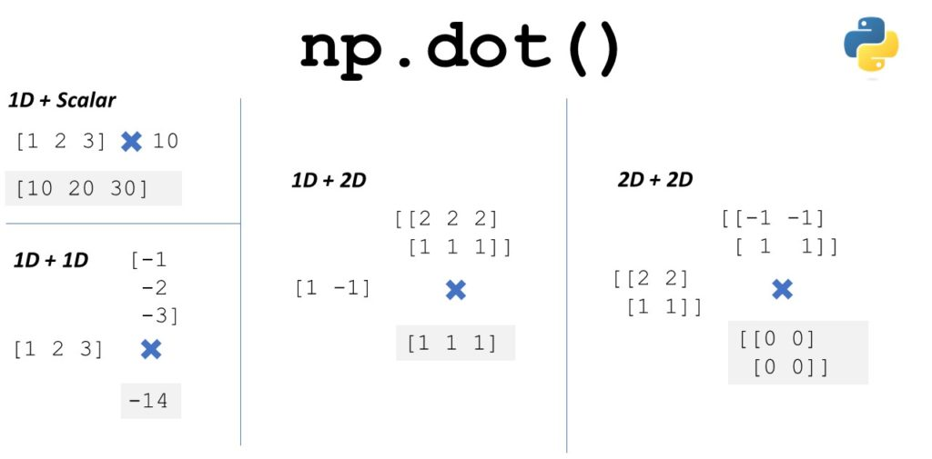
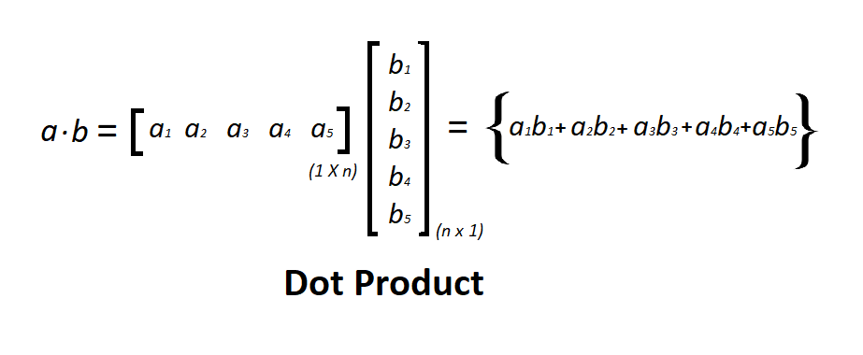
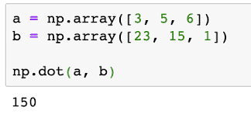
{01}
Fundamentals
XOR Puzzle!

Slide 22

Boolean Logic
IF I have eaten my vegetables AND I am still hungry
THEN I can have ice cream.
IF it’s the weekend OR I am on annual leave THEN I’ll go to the park.
Input A | Input B | AND | OR
0 | 0 | 0 | 0
0 | 1 | 0 | 1
1 | 0 | 0 | 1
1 | 1 | 1 | 1

Slide 23
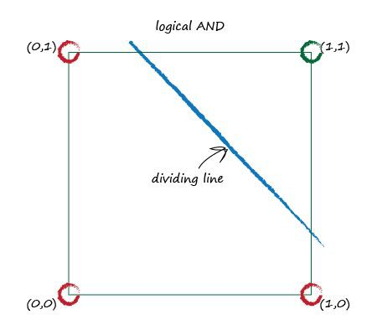
XOR Puzzle!
Input x1 | Input x2 | AND y
0 | 0 | 0
0 | 1 | 0
1 | 0 | 0
1 | 1 | 1

Slide 24
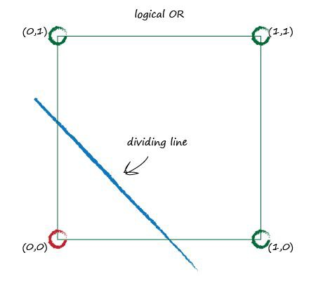
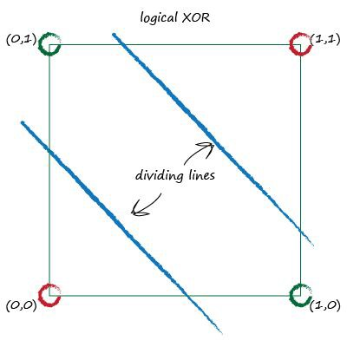
XOR Puzzle!

Slide 25
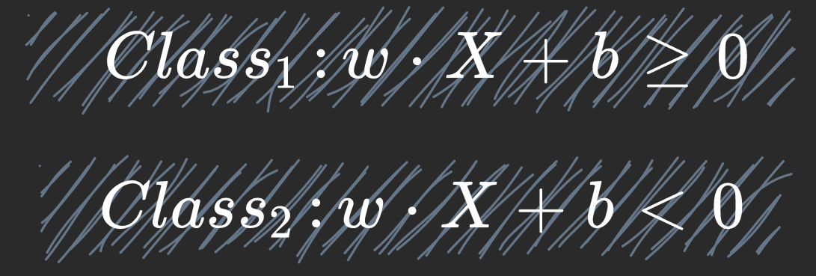
XOR Puzzle!

Slide 26
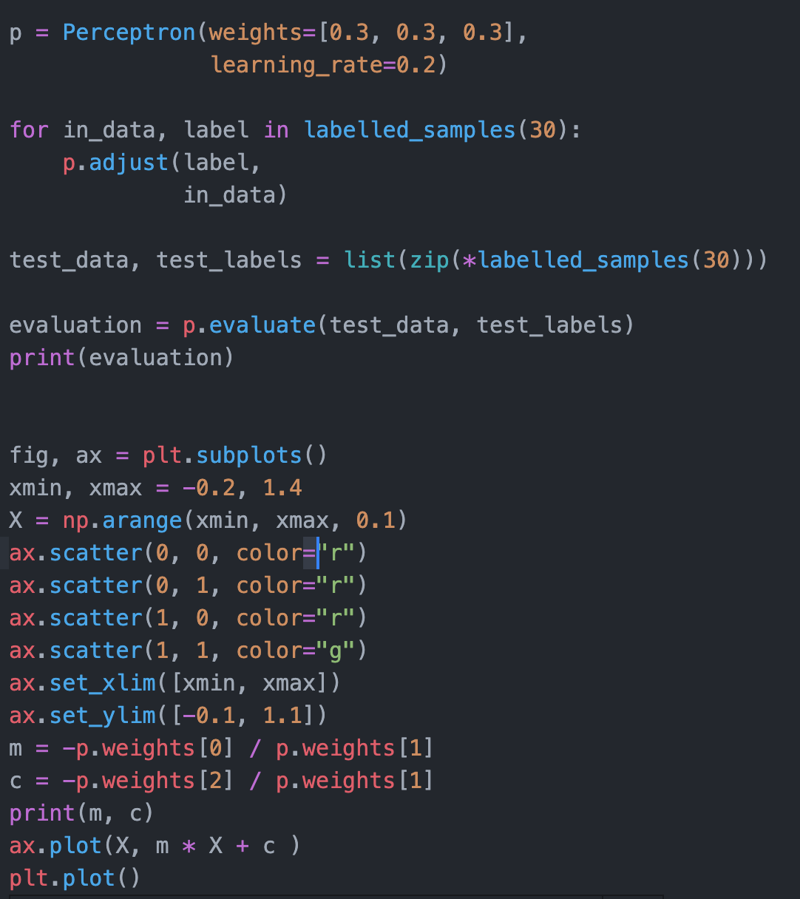
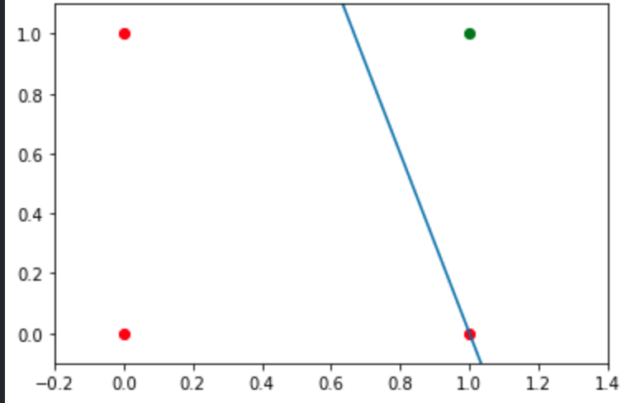
{01}
Fundamentals
XOR Puzzle!

Slide 27
XOR Puzzle!
PYTHON PERCEPTRON MODEL code
import Numpy as np
import Matlibplot.pyplot as plt
Learn how to specify: input/output relationship
Initialize weights
Forward computation

Slide 28
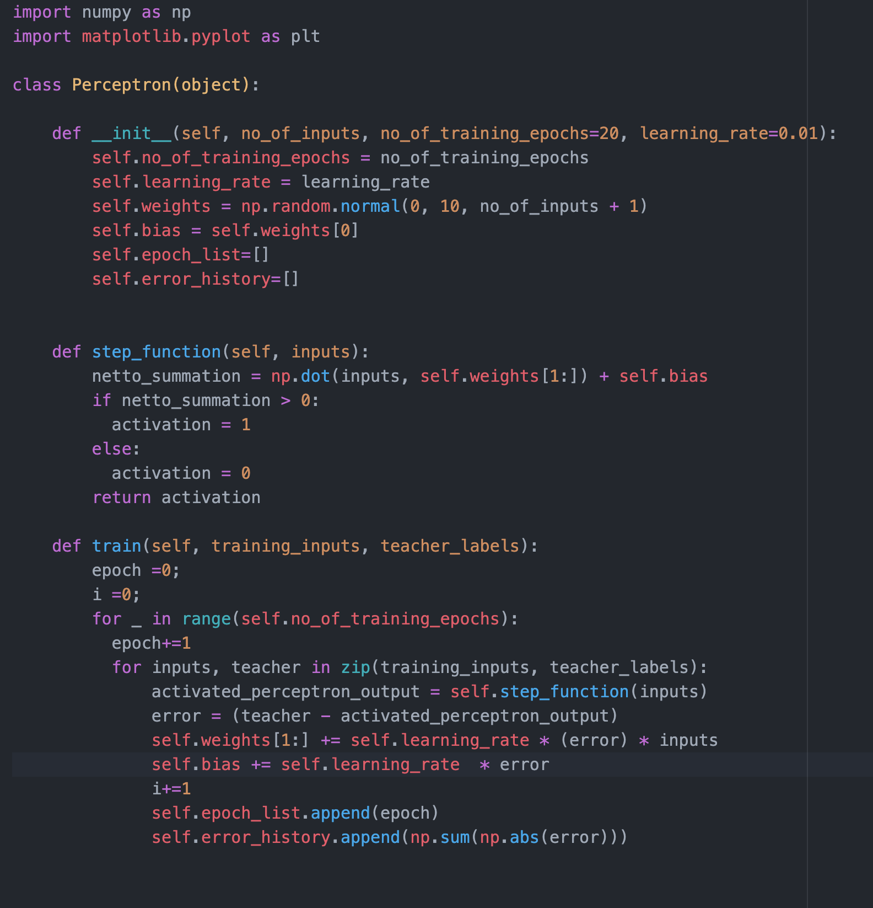
XOR Puzzle!
PYTHON PERCEPTRON MODEL code
import Numpy as np
import Matlibplot.pyplot as plt
Where are input & ouput specified?
Where are the weights initialized?
How is the Forward computation specified?
To Do:
Change the code as to print
Interation number
Bach number
Error
And weights

Slide 29
XOR Puzzle!
PYTHON
INPUT / OUTPUT relationship code
import Numpy as np
import Matlibplot.pyplot as plt
import numpy as np
inputs = []
inputs.append(np.array([1, 1]))
inputs.append(np.array([1, 0]))
inputs.append(np.array([0, 1]))
inputs.append(np.array([0, 0]))
teacher = np.array([1, 0, 0, 0])
USING ZIP
print([inputs for teacher in zip(inputs, teacher)])
print([i for i in zip(inputs, teacher)])

Slide 30
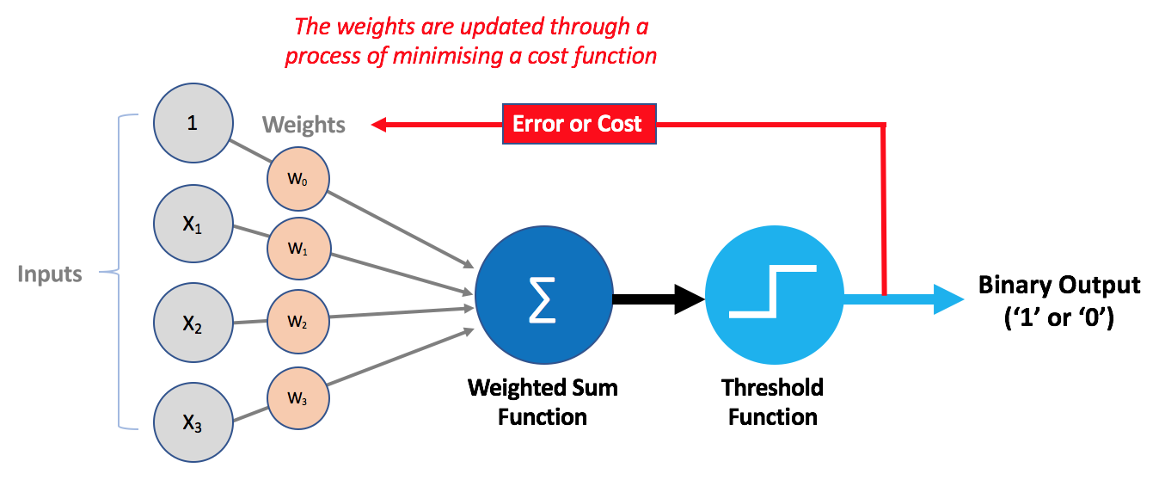
{01}
Fundamentals
XOR Puzzle!
NEXT WEEK:

Slide 31
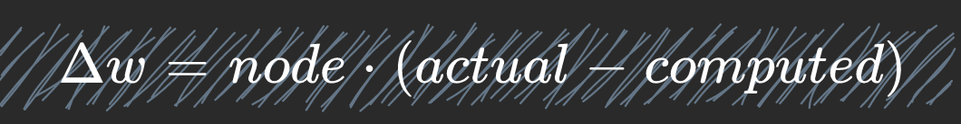
{01}
Fundamentals
XOR Puzzle!
Artificial Neuron Model:
PERCEPTRON maths
Error calculation

Slide 32
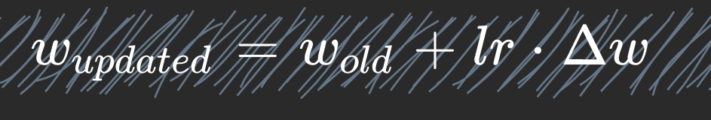
{01}
Fundamentals
XOR Puzzle!
Artificial Neuron Model:
PERCEPTRON maths
FEED BACKWARD calculation

Slide 33


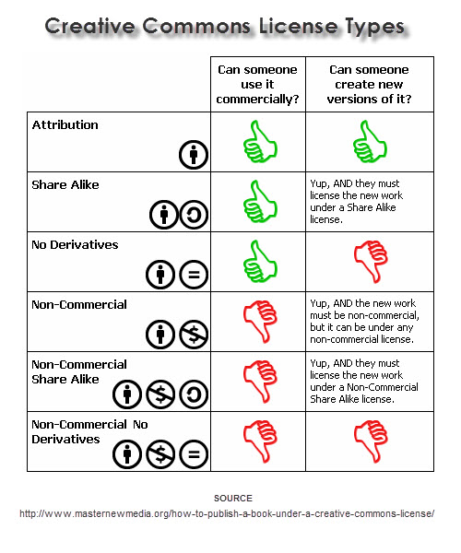
This lesson was developed by:
Robert Frans van der Willigen
CMD, Hogeschool Rotterdam
OKT 2020
http://creativecommons.org/licenses/by-nc-sa/3.0/
This lesson is licensed under a Creative Commons Attribution-Share-Alike license. You can change it, transmit it, show it to other people. Just always give credit to RFvdW.
http://empoweringthenatives.edublogs.org/2012/03/15/creative-commons-licenses/
http://creativecommons.org/licenses/

